Slide 1
Quantum Gas Microscope
Alex An
CM/AMO Club
February 12, 2018

Slide 2
Outline
Introduction to Quantum Gas Microscope
History of Quantum Gas Microscope
Geography of Quantum Gas Microscope
DIY Tutorial on Quantum Gas Microscope
Features of Quantum Gas Microscope
Studies with Quantum Gas Microscope (QGM)
AFM in FHM with fQGM
MBL with bQGM

Slide 3
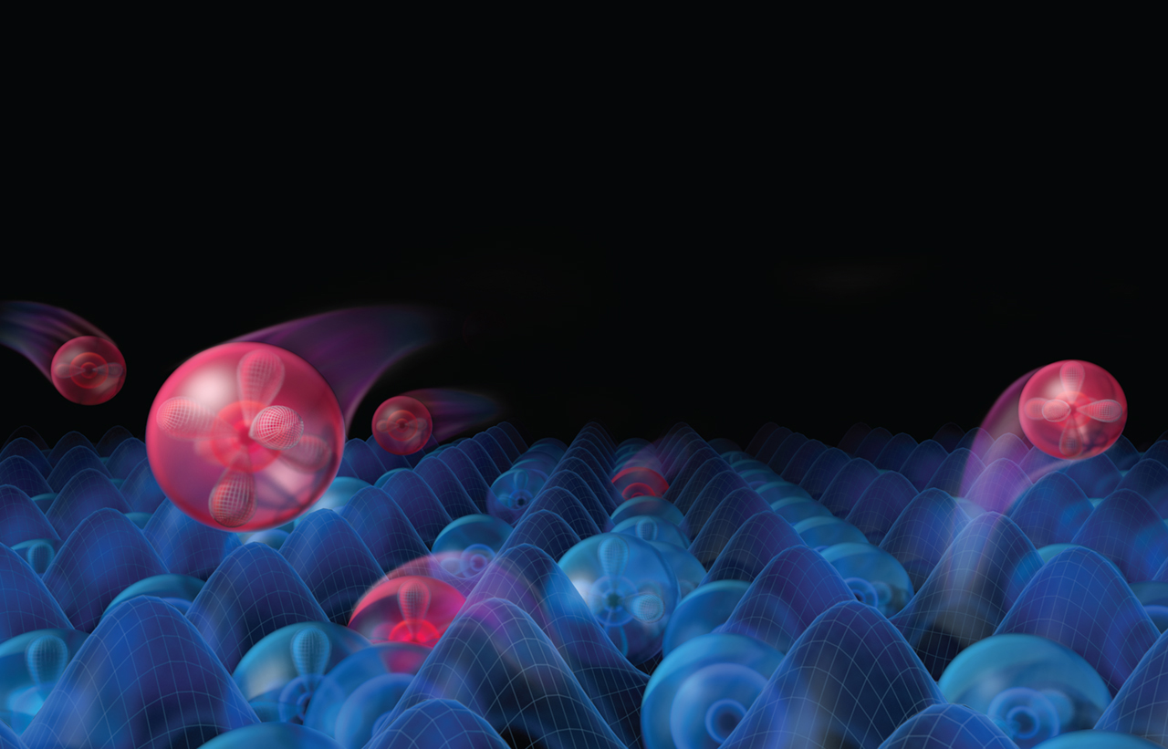
[1/6] Introduction to QGMs
“Quantum simulation”
-Richard P. Feynman
Atoms in optical lattices →
of condensed matter systems
Science 357
But we want more (local) control and observation!
“Quantum gas microscopes”
-Fangzhao A. An

Slide 4
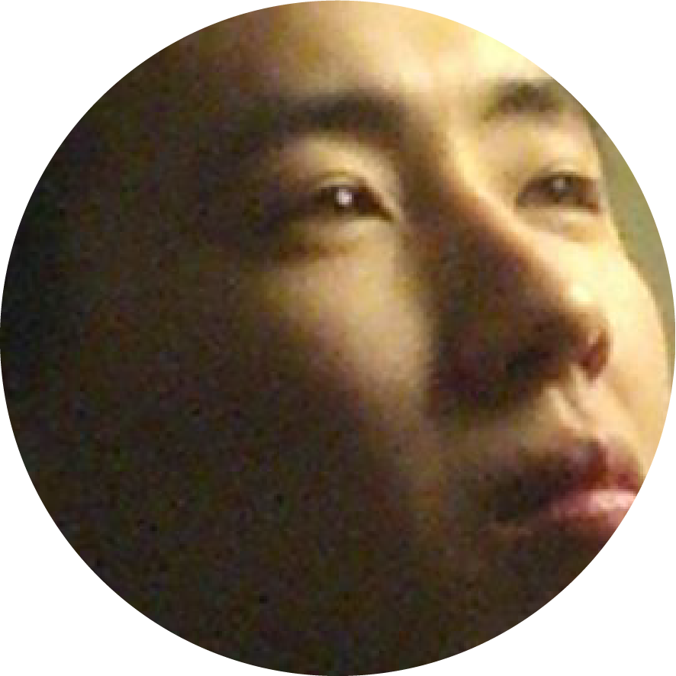
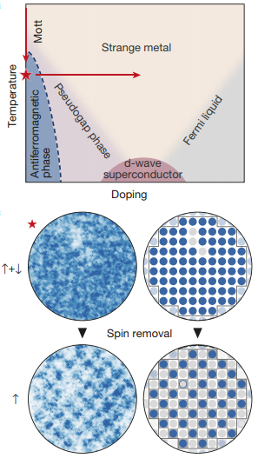
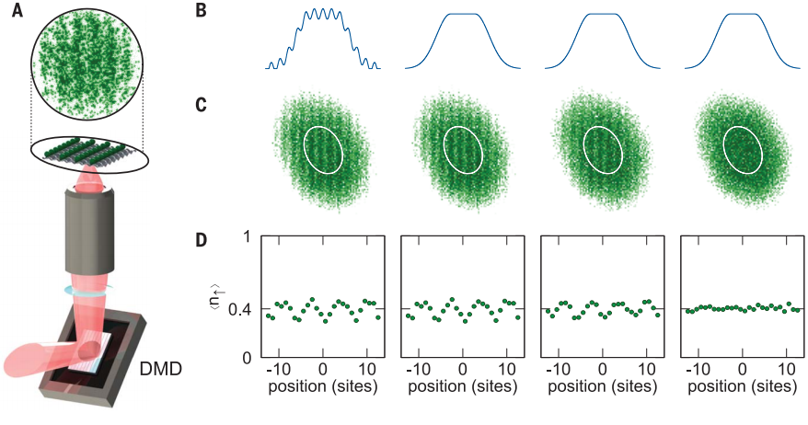
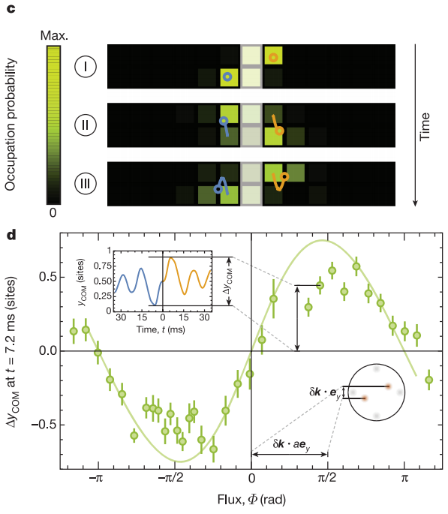
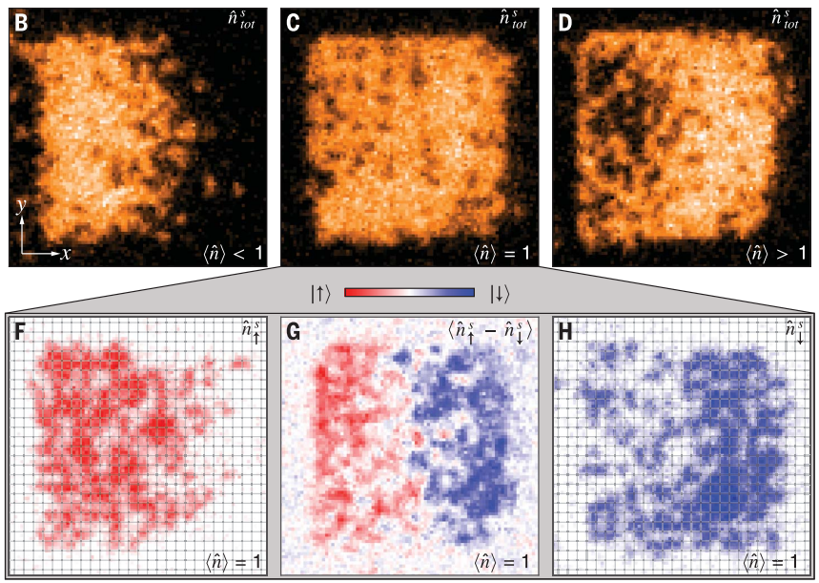
NOT an exhaustive list
[1/6] Introduction to QGMs
A definition (?):
Quantum gas microscopes image atoms in 2D optical lattices with spacing≈0.5μm at the single-site and single-atom scale, for the original purpose of studying (interacting) HUBBARD PHYSICS.
Quantum gas microscopes image atoms in 2D optical lattices at the single-site and single-atom scale.
2D Fermi-Hubbard
Antiferromagnet
Me, 2018
Many-body localization
Me, 2019
Charge transport
Synthetic gauge fields
Brown et al., Science (2019)
Spin transport
Cover of Science 352;
Choi et al. (2016)
Tai et al., Nature (2017)
Nichols et al., Science (2019)
Mazurenko et al., Nature (2017)

Slide 5
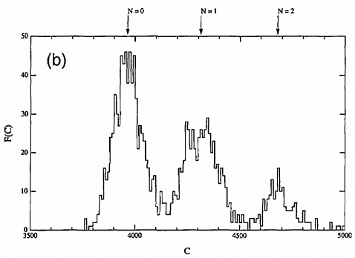
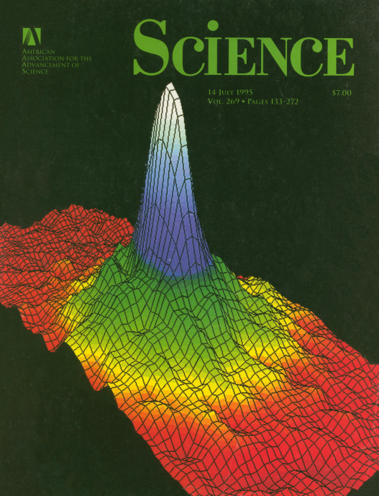
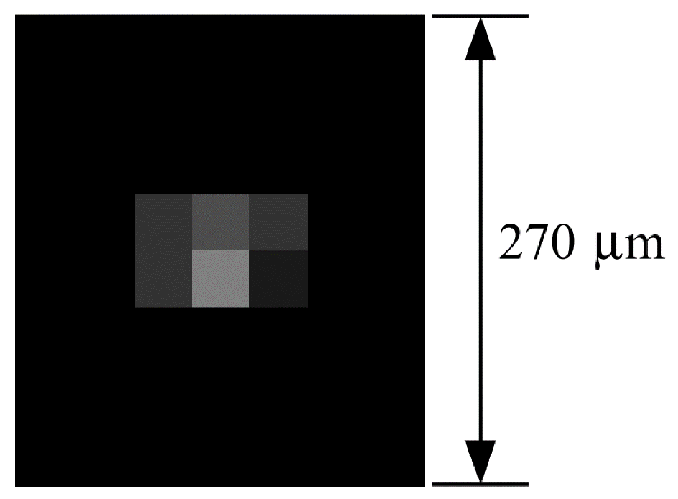
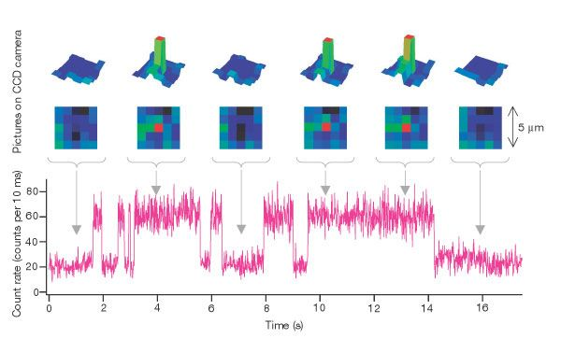
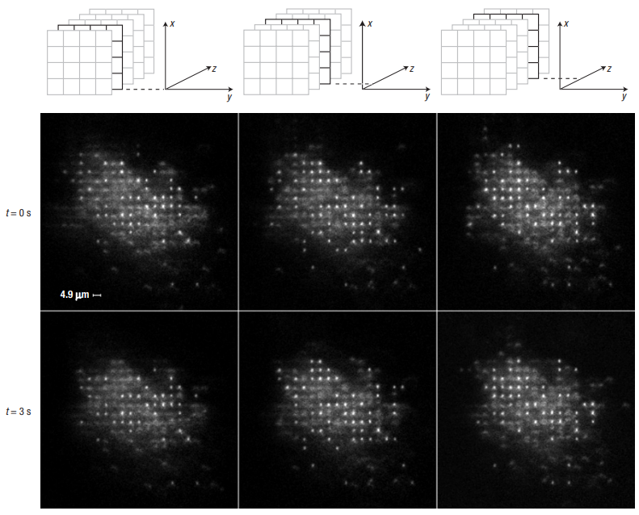
NOT an exhaustive list
1995
[2/6] History of QGMs
Hu and Kimble, Opt. Lett. (1994)
1994
1994: Jeff Kimble makes a MOT with one atom
AMO Annus Mirabilis: BECs
1995
1996: Dieter Meschede does the same thing but a lot better.
2000
2001: Grangier and Meschede load single atoms in optical tweezers
Cover of Science 269 (1995)
2005
2007: Dave Weiss images a big 3D lattice (no tunneling)
Haubrich et al., EPL (1996)
2010
2015
Schlosser et al., Nature (2001)
2020
Nelson, Li, and Weiss, Nat. Phys. (2007)

Slide 6
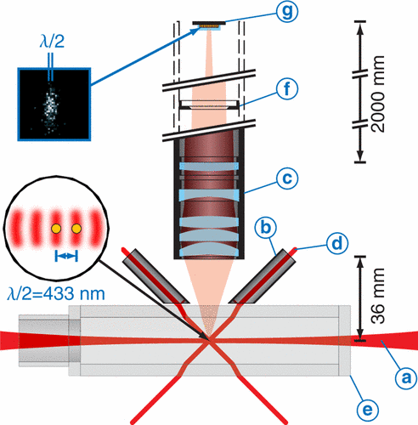
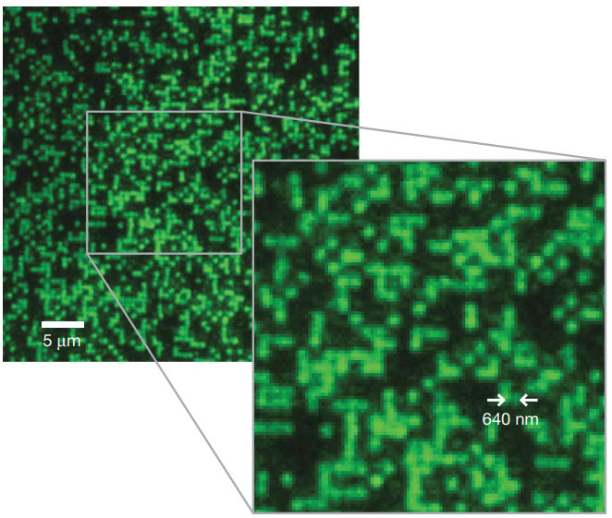
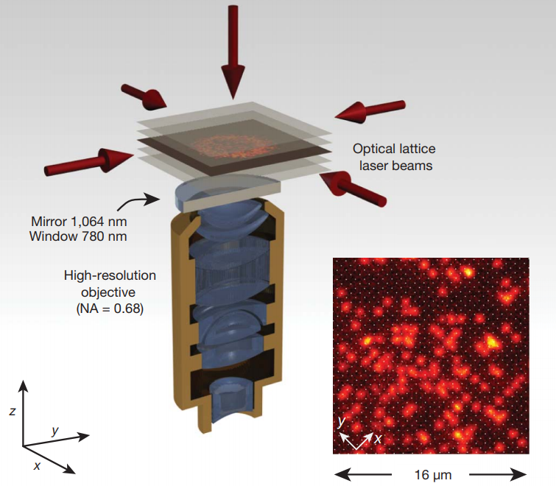
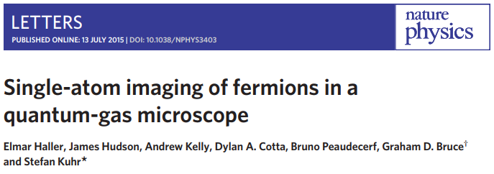
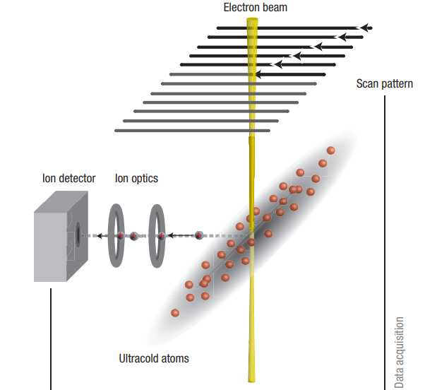
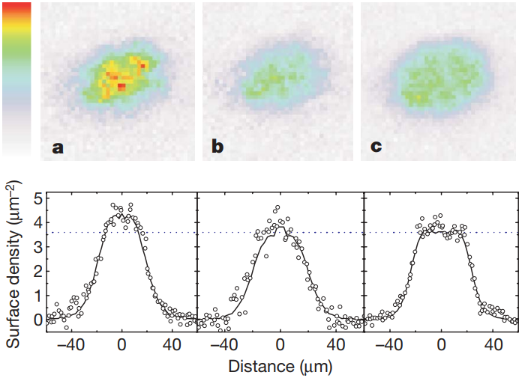
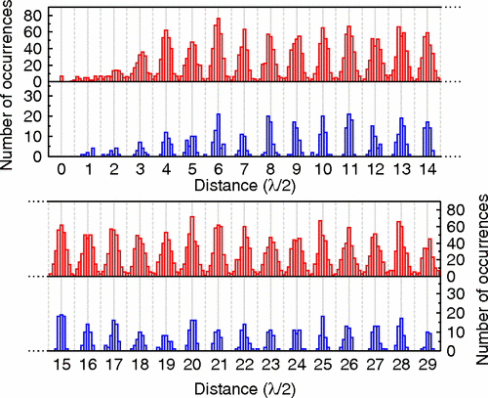
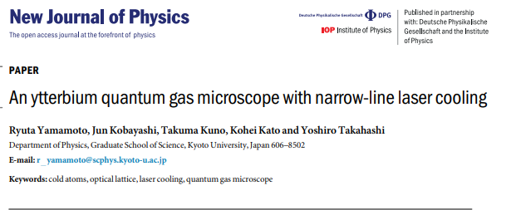
NOT an exhaustive list
Karski et al., PRL (2009)
Bakr et al., Nature (2009)
[2/6] History of QGMs
Sherson et al., Nature (2010)
Gericke et al., Nat. Phys. (2008)
1994: Jeff Kimble makes a MOT with one atom
1994
Gemelke et al., Nature (2009)
1995
1996: Dieter Meschede does the same thing but a lot better.
Ye Olde micro(horo)scope forecast
2020: Cesium microscope [Monika Aidelsburger@Bloch]
2022: Strontium microscopes [Florian Shreck, Sebastian Blatt@Bloch]
2035: Erbium microscope [Greiner lab]
2050: Molecule microscope [Simon Cornish, Jun Ye (?), Bloch (?)]
superfluid
Mott insultator
2000
2001: Grangier and Meschede load single atoms in optical tweezers
2005
2007: Dave Weiss images a big 3D lattice (no tunneling)
2007/8: Herwig Ott comes out of left field with SEM of atomic clouds
2008/9: Dieter Meschede images a 1D lattice with single atom/site resolution
2008/9: Cheng Chin makes a Cs microscope nearing single-atom resolution
2010
2009: Markus Greiner makes the first quantum gas microscope
2015
2009/2010: Immanuel Bloch + Stefan Kuhr follow it up with a hefty #2
2015: Kuhr, Zwierlein, Gross/Bloch, Thywissen, and Greiner make the first FIVE fermionic quantum gas microscopes
2020
2015: Takahashi and Kozuma each make non-alkali [Ytterbium] microscopes
Nelson, Li, and Weiss, Nat. Phys. (2007)

Slide 7
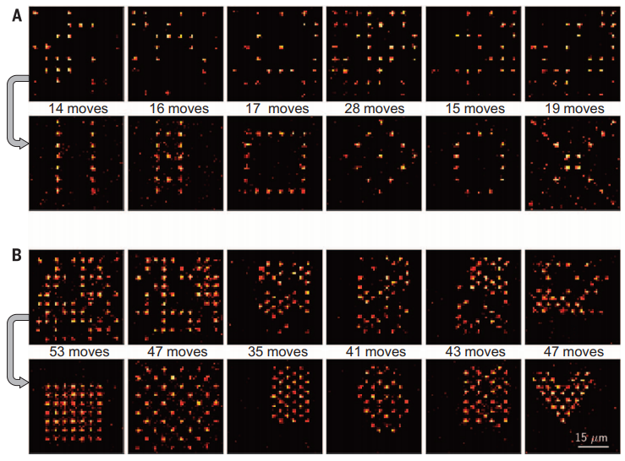
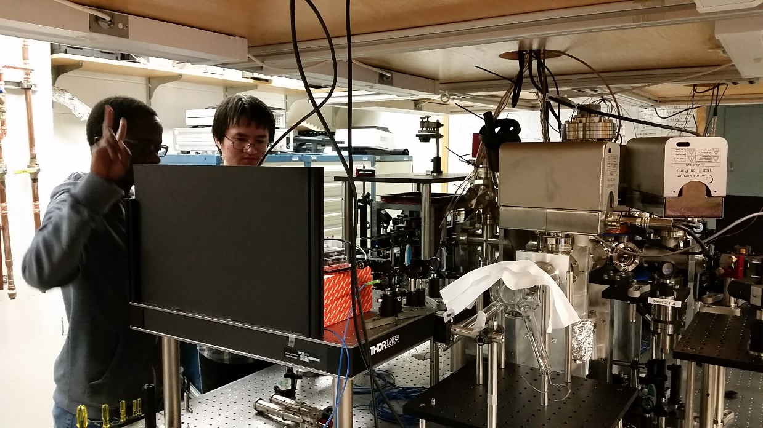
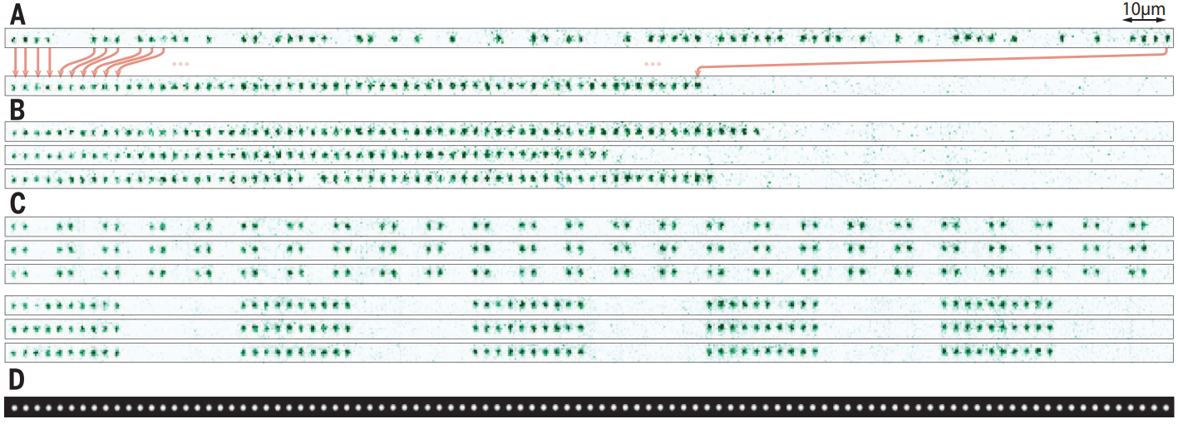
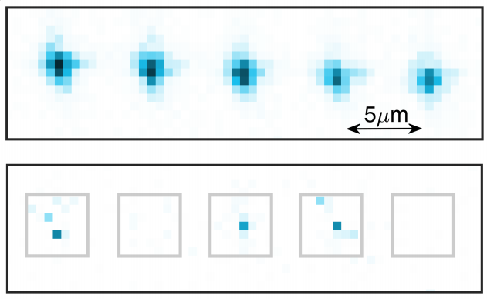
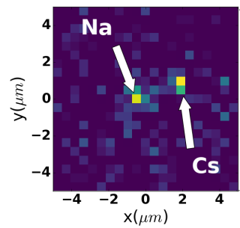
NOT an exhaustive list
[2.5/6] Aside: Optical tweezer arrays
Similar to QGMs
Loading & imaging single atoms in tweezers
Highly tunable with precise control over tweezer positions
However, large “lattice constants” means ill-suited for Hubbard physics
Lots of different and cool applications
Lots of cool people
Jackson Ang’ong’a
Zejun Liu
Pic of Jackson and zejun
Barredo et al. [Browaeys group], Science (2016)
Other cool tweezer work…
Molecule tweezer array
Anderegg et al. arXiv:1902.00497
Endres et al. [Lukin group], Science (2016)
Liu et al. arXiv:1902.03935

Slide 8
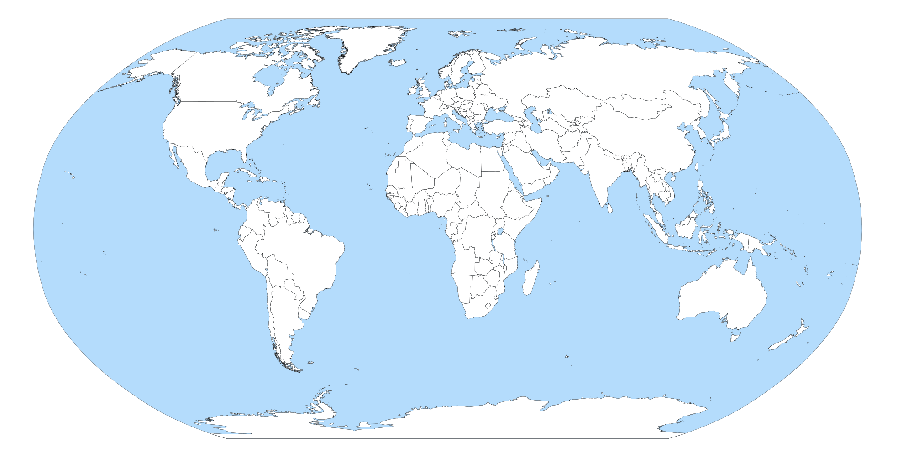
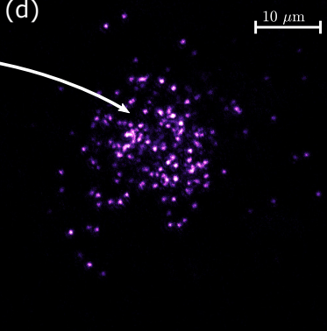
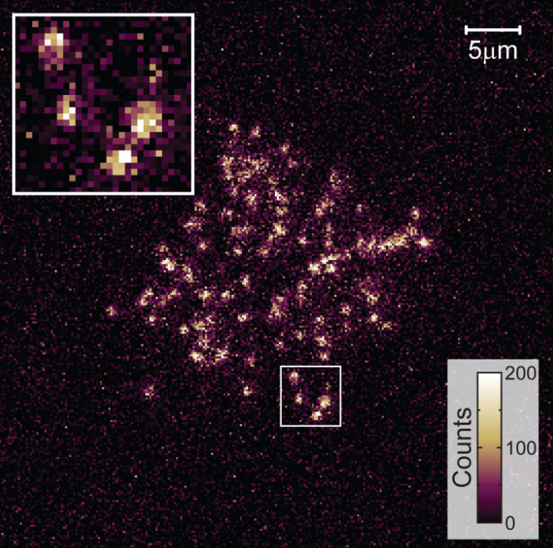
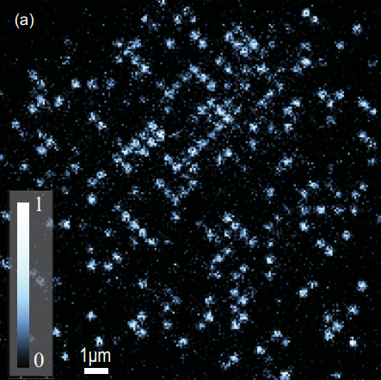
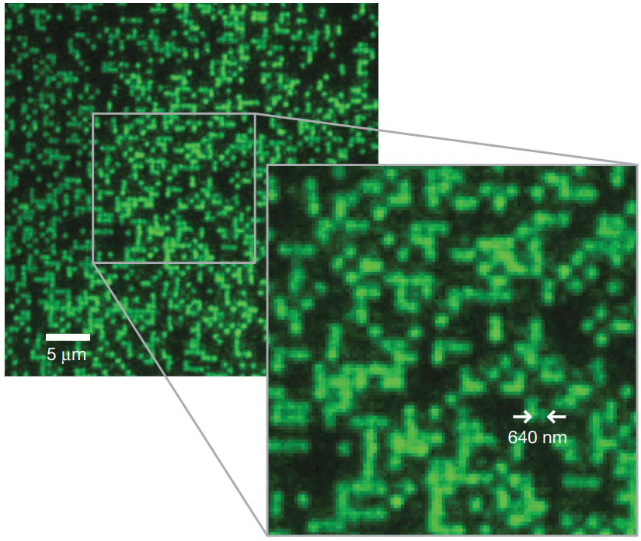
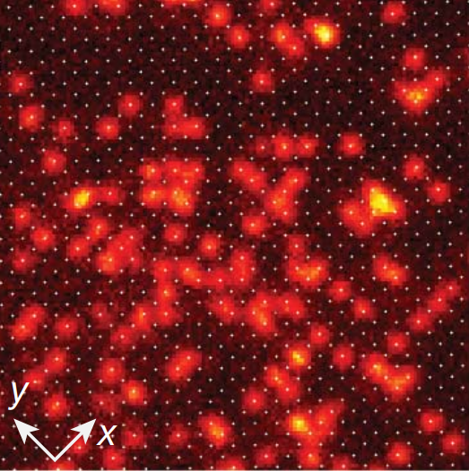
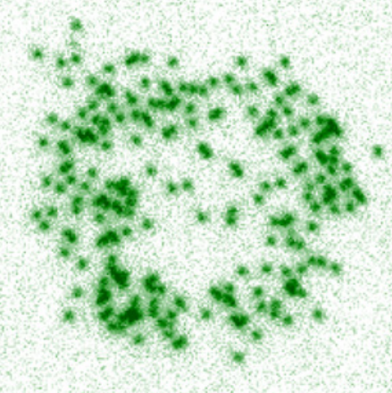
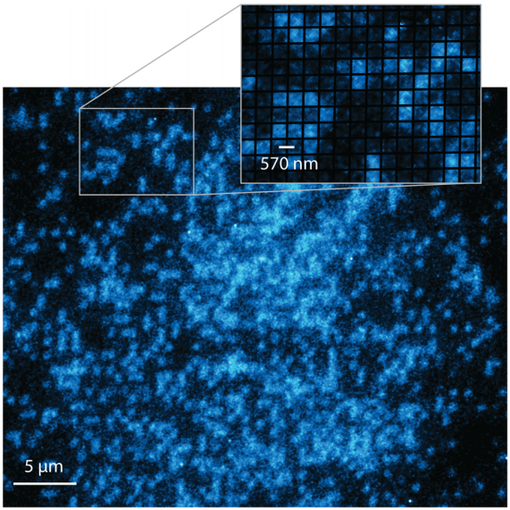
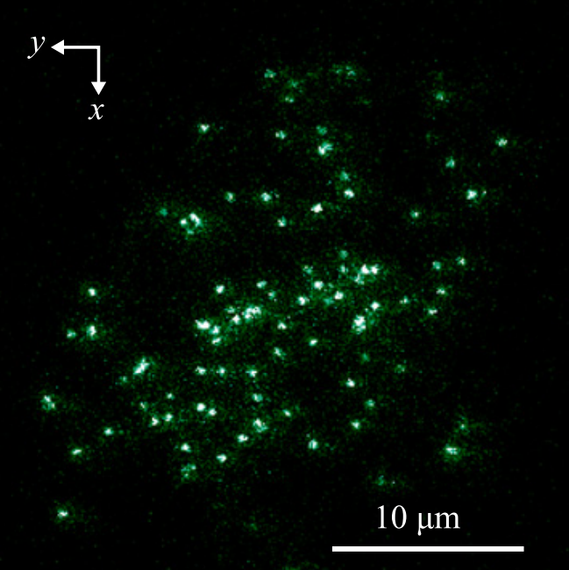
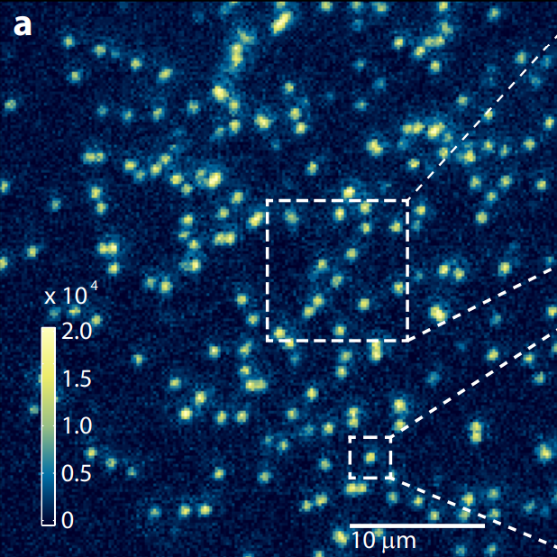
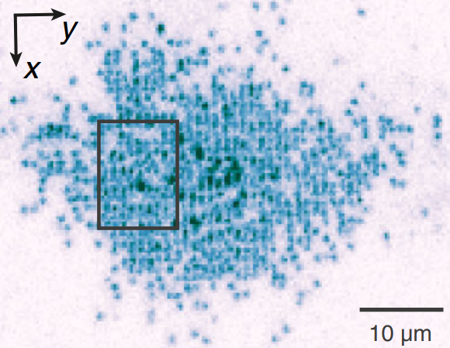
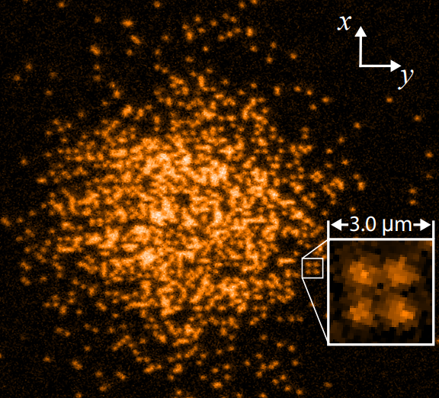
NOT an exhaustive list
⁴⁰K
¹⁷⁴Yb
[3/6] Geography of QGMs
⁸⁷Rb
Sherson@Aarhus
Thywissen@Toronto2015
Bosonic QGMs
⁸⁷Rb
Fermionic QGMs
⁸⁷Rb
Kozuma@TokyoTech2014
Non-Alkali QGMs
⁶Li
Greiner@Harvard2009
¹⁷⁴Yb
⁴⁰K
Bloch/Kuhr@Munich2010
⁶Li
Bakr@Princeton
⁴⁰K
⁶Li
Greiner@Harvard2015
Takahashi@Kyoto2015
Kuhr@Strathclyde2015
Bloch/Gross@Munich2015
Zwierlein@MIT2015
and more!!!!

Slide 9
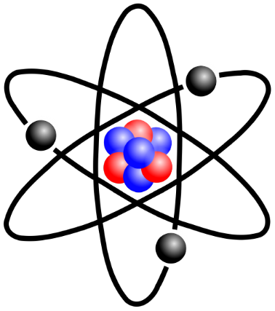
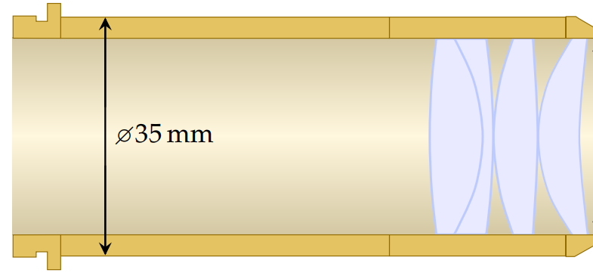
NOT an exhaustive list
[4/6] DIY Tutorial on QGMs
Just three easy steps!
Expensive objective with high numerical aperture
Atoms in a 2D plane really close to the objective
A way to cool atoms while [fluorescence] imaging
Overcome years of experimental challenges and self-doubt

Slide 10
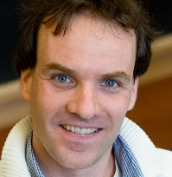
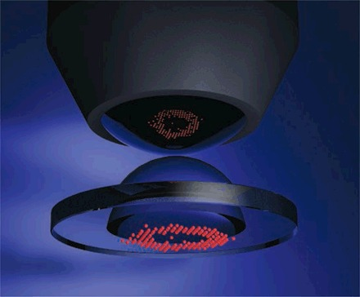
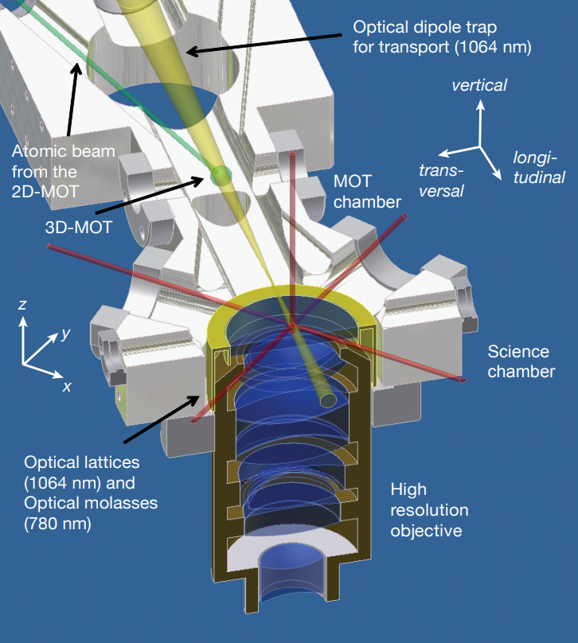
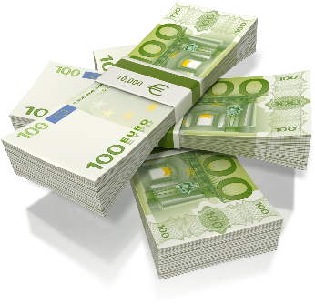
NOT an exhaustive list
[4/6] DIY Tutorial on QGMs: Greiner vs. Bloch
1
Lattice comes through
microscope objective
One 2D plane of a vertical lattice
Additional lens in vacuum
2
2
Hybrid evanescent wave + dipole trap
Waseem Bakr thesis (2011) [Greiner group]
1
Christof Weitenberg thesis (2011) [Bloch group]
Just three easy steps!
Expensive objective with high numerical aperture
Atoms in a 2D plane really close to the objective
A way to cool atoms while [fluorescence] imaging
For bosons (above ‘scopes): optical molasses (Sisyphus/polarization gradient cooling)
For fermions: Raman-sideband cooling or electromagnetically-induced transparency cooling

Slide 11
NOT an exhaustive list
Tweezers, etc.
Mott insulator
+ evaporation
[5/6] Features of QGMs
Laser-induced tunneling
Lattice
DMDs
Feshbach resonances
Quantum gas microscopes can do anything in 1D/2D as without microscopes: Lattice models with control over tunneling, potential landscape, lattice geometry, atom number/chemical potential, interaction strength, topology, and even single-site manipulation.
Markus Greiner
Interactions + doping
Interactions + disorder
Interactions + potential
Interactions + topology
Brown et al., Science (2019)
Interactions + spin-dep. potential
Cover of Science 352;
Choi et al. (2016)
Tai et al., Nature (2017)
Nichols et al., Science (2019)
Mazurenko et al., Nature (2017)

Slide 12
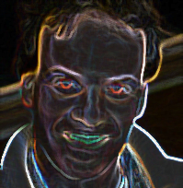
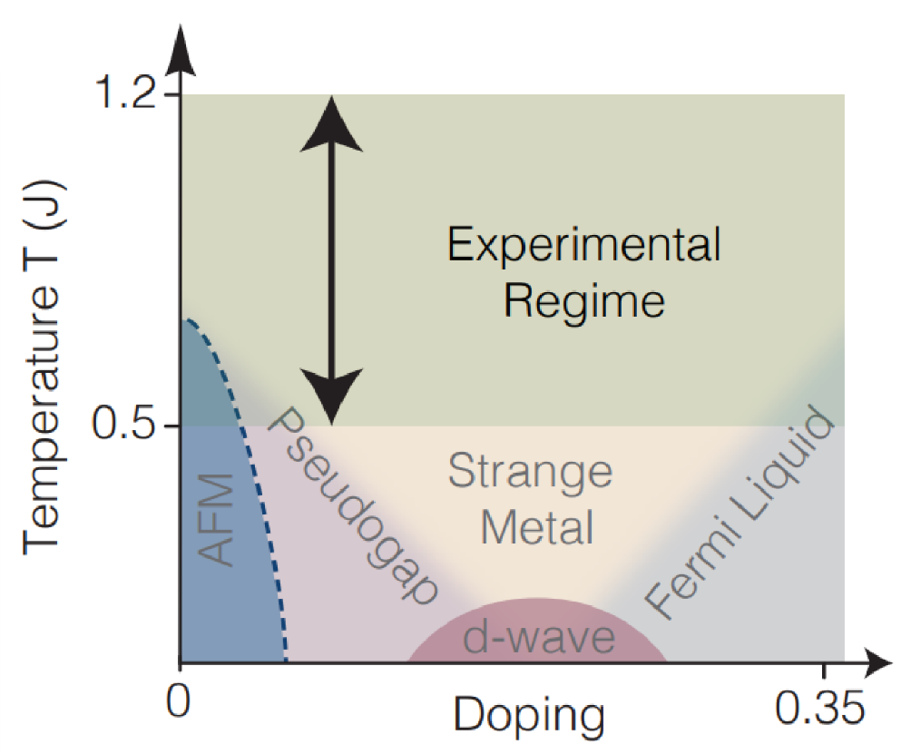
NOT an exhaustive list
[5/6] Features of QGMs
BUT… they have limitations. From experimental challenges like lack of optical access and restrictions to 1D/2D… to lacking spin and number resolution in the data*… to physics concerns like still not being cold enough for the most interesting Fermi-Hubbard physics.
Grarkus Meiner
* tricks exist
Philipp Preiss thesis (2015) [Greiner group]
(not really a QGM limitation)
Christof Weitenberg thesis (2011) [Bloch group]
Chiu et al., arXiv:1810.03584 [Greiner group]

Slide 13
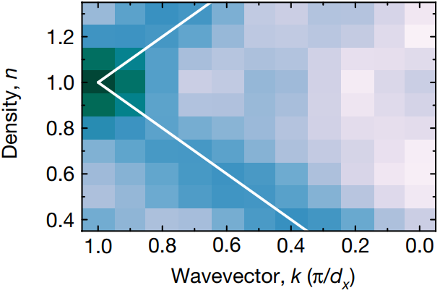
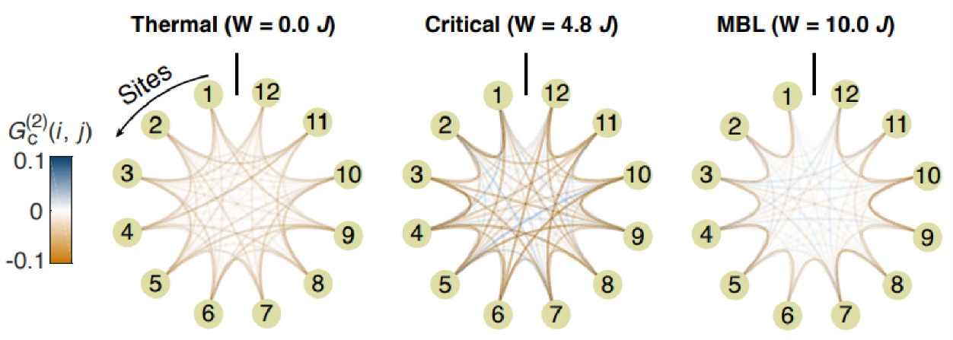
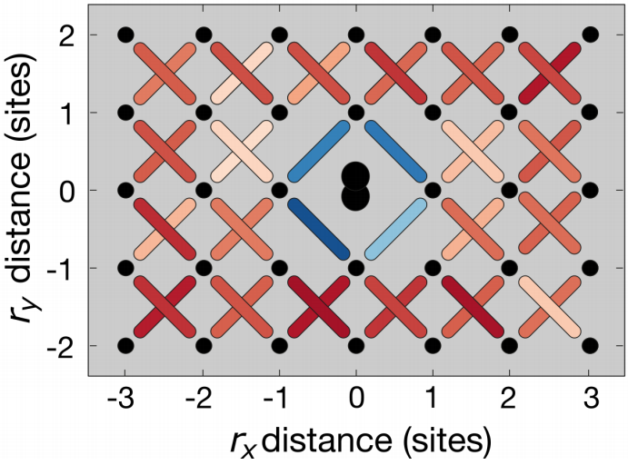
NOT an exhaustive list
[6/6] Studies with QGMs
Antiferromagnetism in
the Fermi-Hubbard model
Many-body localization
transition with 1D disorder
[bosons]
Hilker et al., Science (2017)
Salomon et al., Nature (2019)
arXiv:1805.09819
German genius
arXiv:1811.06907
[Bloch group]
arXiv:1812.06959
[Greiner group]

Slide 14
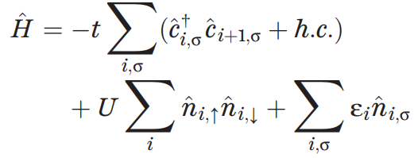
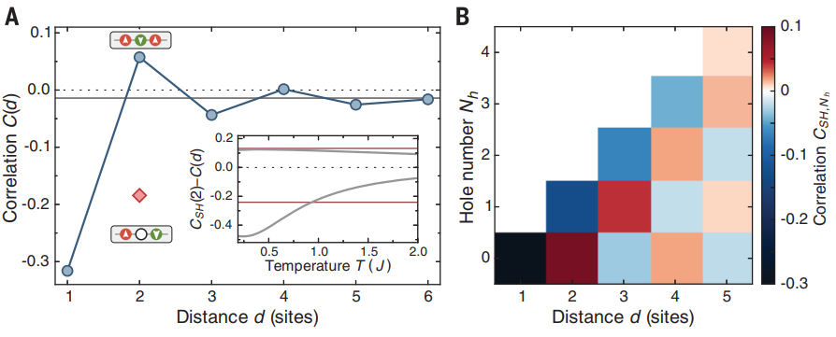
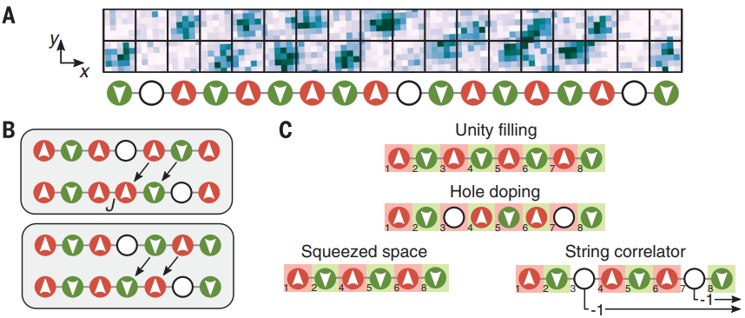
NOT an exhaustive list
[6/6] Studies with QGMs: AFM in Fermi-Hubbard
The papers [Bloch group]:
Hidden AFM order: Hilker et al., Science (2017)
Incommensurate magnetism: Salomon et al., Nature (2019)
Polarons: arXiv:1811.06907
Procedure
Prepare atoms in a 2D quantum pancake.
Separate individual 1D tubes of the pancake.
Ramp up lattice strength and interactions to F-H levels, and dope.
Image different spins with Stern-Gerlach + superlattice.
The 1D Fermi-Hubbard model in the antiferromagnetic regime
Half-filling (1 atom/site)
Boll et al., Science (2016)
Heisenberg spin chain
(AFM)
Science
+ doping
Hilker et al., Science (2017)
Luttinger liquid
Dopants move around →
“Hidden” AFM correlations
Regular AFM order
Dopant (hole) acts as a domain wall

Slide 15
NOT an exhaustive list
[6/6] Studies with QGMs: AFM in Fermi-Hubbard
The papers [Bloch group]:
Hidden AFM order: Hilker et al., Science (2017)
Incommensurate magnetism: Salomon et al., Nature (2019)
Polarons: arXiv:1811.06907
Take the hidden order study and vary the density $n$ (and polarization $m$). Measure spatial frequency of resulting “spin-density wave.”
Now change the lattice to 2D!
(no doping)
Vary density (doping)
Vary polarization
polaron
Incommensurate!

Slide 16
NOT an exhaustive list
[6/6] Studies with QGMs: AFM in Fermi-Hubbard
The papers [Bloch group]:
Hidden AFM order: Hilker et al., Science (2017)
Incommensurate magnetism: Salomon et al., Nature (2019)
Polarons: arXiv:1811.06907
Take the 2D result from the last paper, and look at correlations EVERYWHERE in the presence of a DOUBLON ($↑↓$). Compare mobile doublon to “pinned” doublon. See polarons.
Extracted data…
NN
‘Raw’ data
Doublon frame
diagonal
Doublon frame
no polaron signatures!
polaron
Polaron “size”?
NNN
To be continued…

Slide 17
NOT an exhaustive list
[6/6] Studies with QGMs: MBL in 1D with bQGM
The papers [Greiner group]:
Lots of previous work
Measuring MBL transition with entanglement: arXiv:1805.09819
MBL transition critical behavior: arXiv:1812.06959
I ran out of time making this presentation!!

Slide 18
[7/6] Thanks

